Slide 1





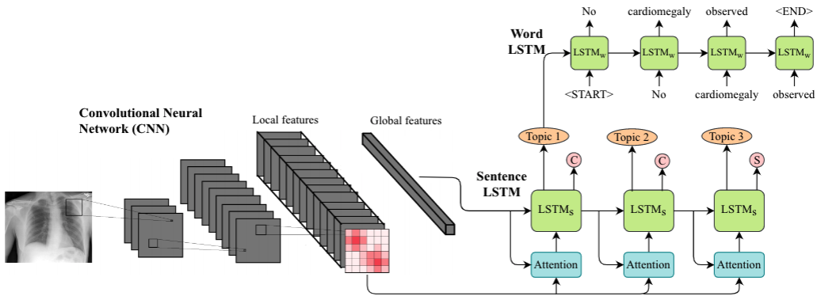
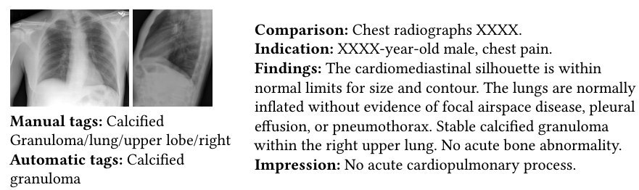
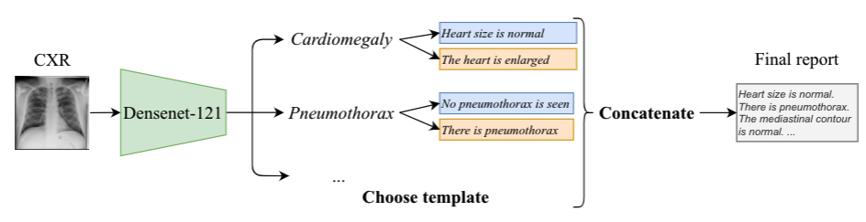
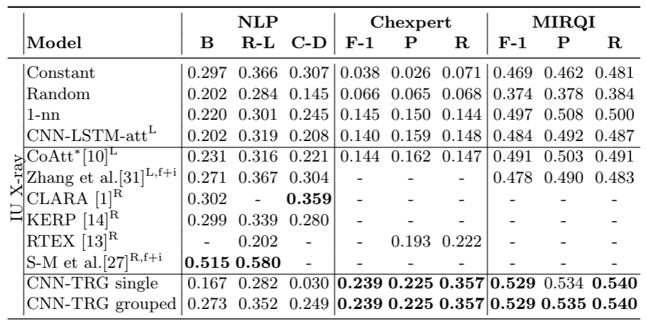
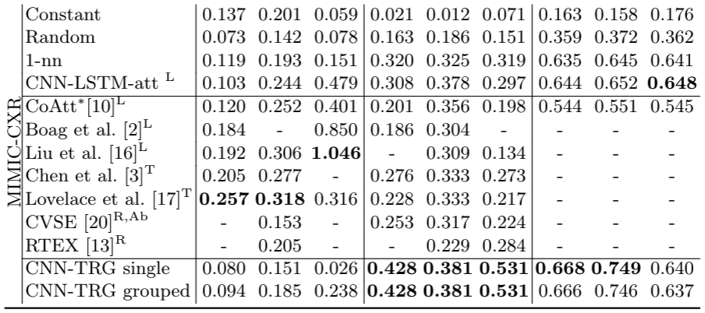
Clinically Correct Report Generation
from Chest X-Rays
using Templates
Pablo Pino, Denis Parra, Cecilia Besa, Claudio Lagos
Pontificia Universidad Católica de Chile
Introduction
Traditional Architecture: Encoder Decoder
Conclusions
Using Artificial Intelligence (AI) for medical image report generation (MIRG) could help hospitals deal with a large and growing demand of image-based clinical exams
SOTA models focus too much on NLP metrics (BLEU, ROUGE, etc.), which undermines its performance on clinical correctness (matching the diagnostics)
In this article we focus on generating the Findings section from chest X-rays.
CNN-TRG Clinical Correctness. Our template-based models outperform all other models (naïve and DL-based) in terms of clinical correctness, both in Chexpert and MIRQI F-1 scores.
NLP vs Clinical Correctness. Naive models achieve higher NLP performance than CNN-TRG and comparable to some SOTA models, even though they are not clinically useful by design. However, naive models achieve very low performance on Chexpert and MIRQI.
Language Decoder
Visual Encoder
CNN-TRG
Future Work
Expand to other pathologies and types of images (MRI, CT-Scan, Ecography, etc.): current work is limited to the 13 abnormalities classified by Chexpert and only on X-rays.
Deal with multimodal input: consider not only the image, but also the background information, specially to generate the Impression section of the report.
Explainable AI: our solution allows to easily integrate visual explainability methods such as CAM o Grad-CAM
Experiments
We use both IU X-ray and MIMIC-CXR datasets, keeping only frontal X-rays.
We compare our proposed solution (CNN-TRG) with naive baselines as well as SOTA methods
Among the naive baselines, we consider a fixed constant report, random reports, and a memory-based 1-NN report (retrieve the report of the most similar image)
We compared the results of SOTA models reported in the literature.
Results
IU dataset
MIMIC-CXR dataset
Acknowledgements
ANID/FONDECYT 1191791. Instituto Milenio IMFD, convenio IMC-ANID.
Notes:
‹#›

